Slide 1

Project Detailed Presentation
Arunpriya Gobinath || 100841238
Jugnu Sheffin || 100814025
Ramasubramanian Dharumaperumal || 100810343
Raj Dholakia || 100813041
Sourabh Potdar || 100844478
Product Manager: Marcos Bittencourt

Slide 2


Table of Contents
Problem Description
Solution Description
Project Scope
Technologies
Extension Version 1 - Expectations
Algorithm Version 1 – Expectations
Final Version – Project Evaluation
Project Assumptions & Constraints
Project Milestones & Schedule

Slide 3
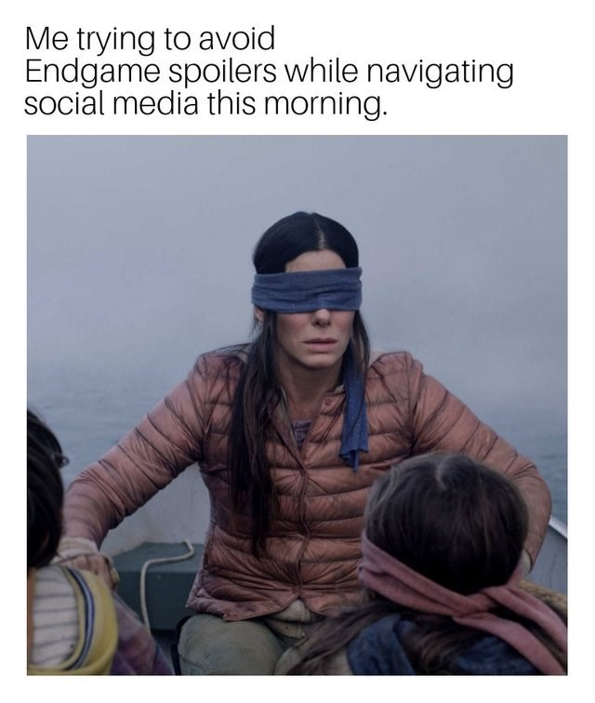
Problem Description
What's a Spoiler really?
A spoiler is an element of disseminated information that reveals the plot of a movie, book, series, play, or any other media or literature (Source: Oxford English Dictionary).
Need to bust spoilers!
Spoilers spoil the fun and the thrill by revealing the climax that the potential consumer was not intended to know. It's like reading the last chapter of Agatha Christie novel soon after you buy it.
Internet is full of spoilers and we must be able to control whether we to reveal/hide the suspense.

Slide 4
Solution Description
Spoiler Buster is a browser Extension that filters out search result and text on web pages that "spoil" or reveal plot elements of the media.
Algorithm
When the user searches about any shows/movies, spoiler texts are first spotted by the ML algorithm.
These spoiler texts are either blocked or replaced with colors, images and gifs.
Extension
User can customize the spoiler keywords he wants the algorithm to concentrate on.
User can choose the movies for which he wants to block spoilers.
User can also choose the color, image or gif to replace the spoiler text with.

Slide 5
Project Scope
The main goal of the project is to develop a google chrome extension which can filter spoilers from an open webpage by using a machine learning model to detect spoilers text extracts.
In-scope deliverables
A chrome extension with a simple user interface.
Acquire, clean and prepare the data for training the machine learning algorithm.
Design, build and deploy the machine learning algorithm to successfully classify the spoiler from a text extract.
Create a prototype by integrating the machine learning model to the browser extension.
Out-of-scope deliverables
Gaining users for the extension.
Data collection for model training.

Slide 6





Technologies to be Used
Python
Machine learning libraries : Scikit-learn, TensorFlow
HTML/CSS/JavaScript for building the browser extension
Google cloud platform
Git and GitHub for code management and version control.

Slide 7
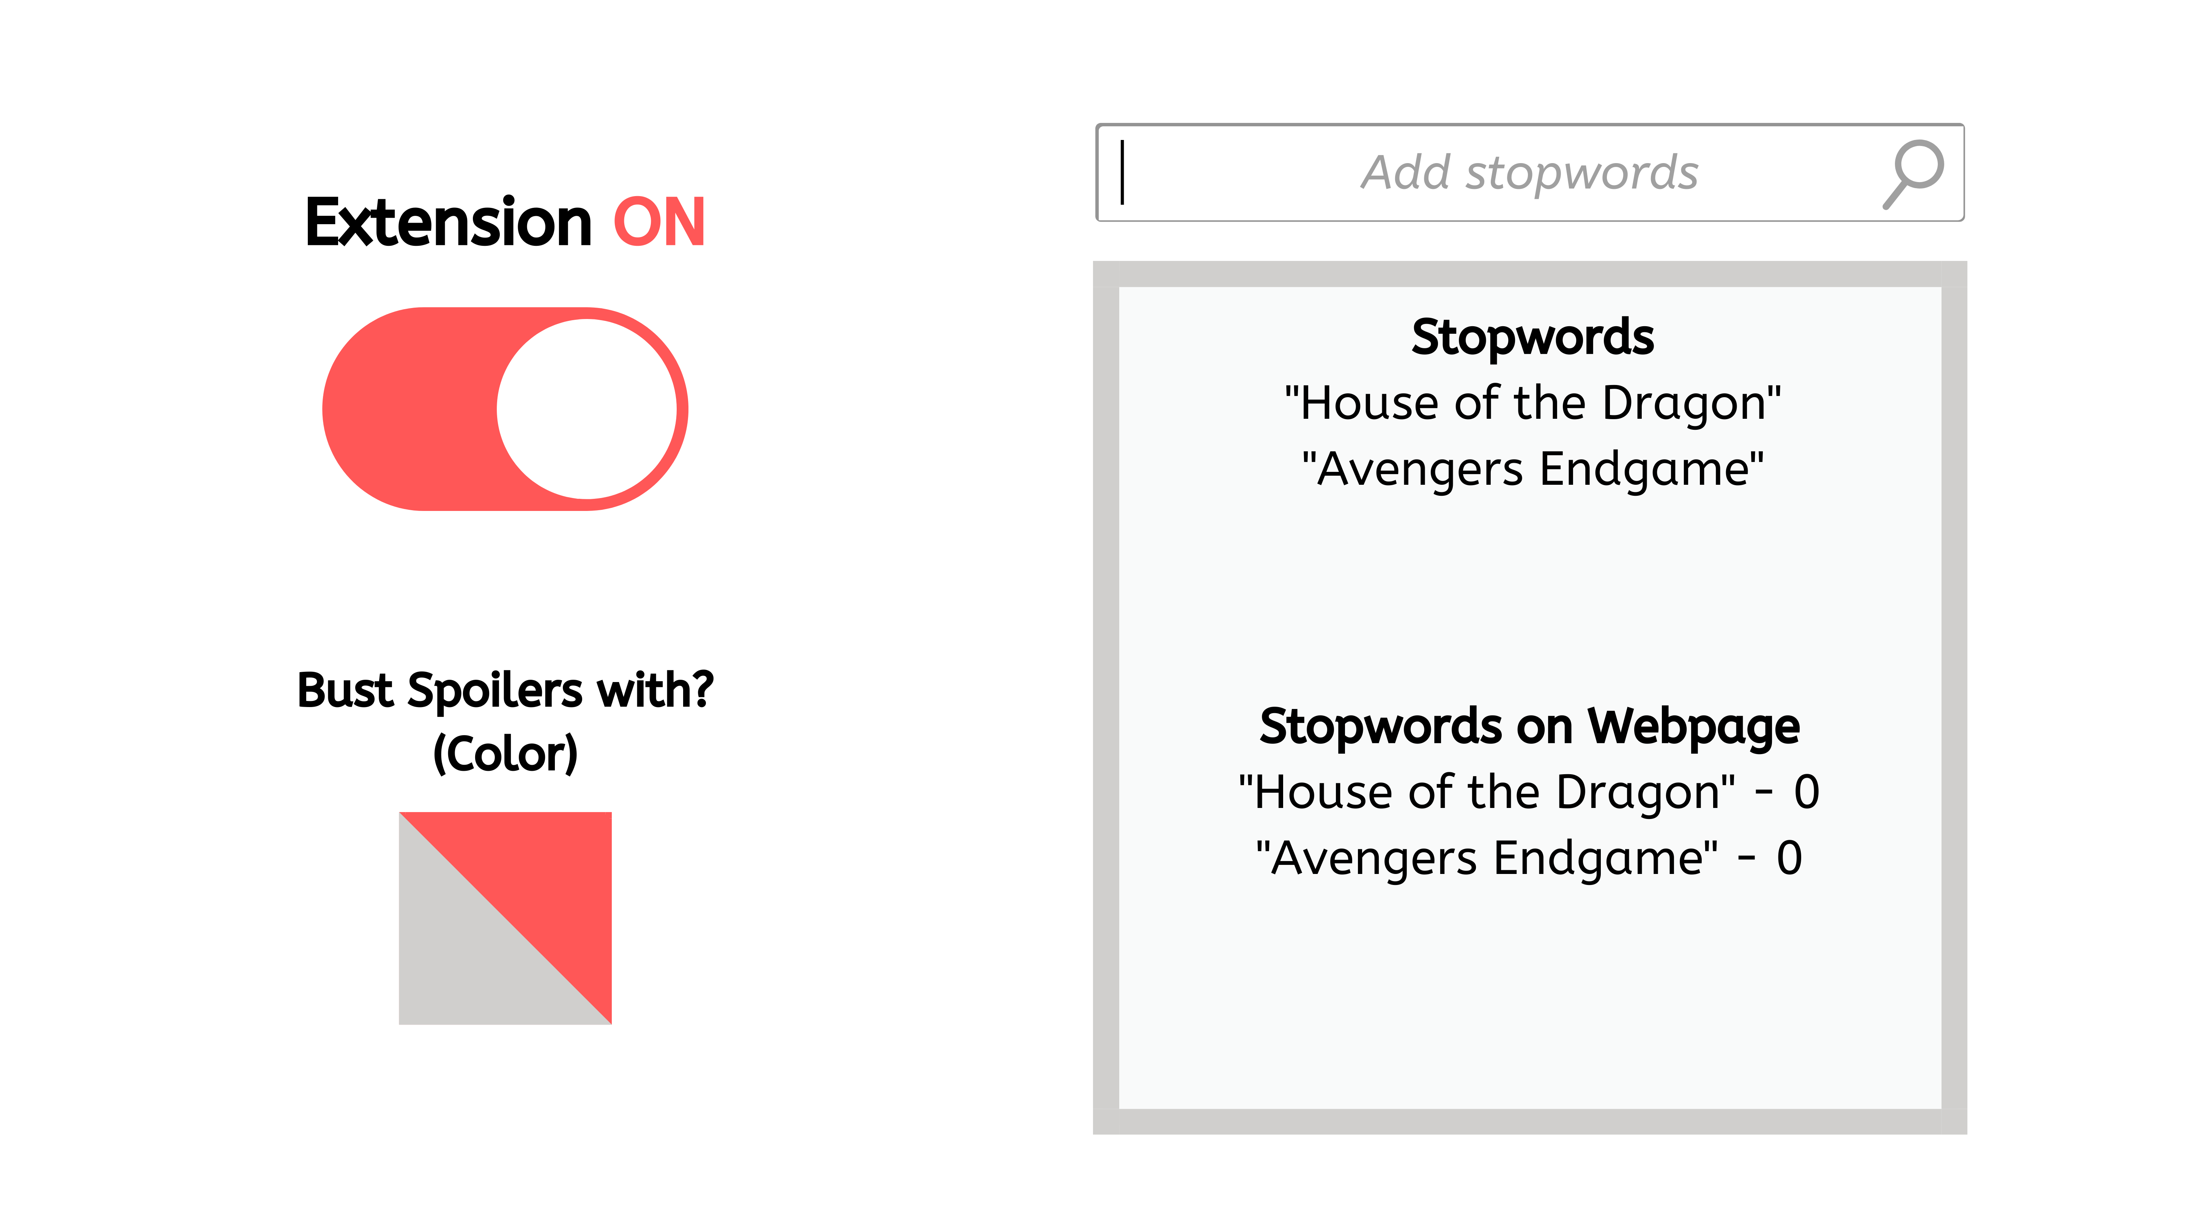
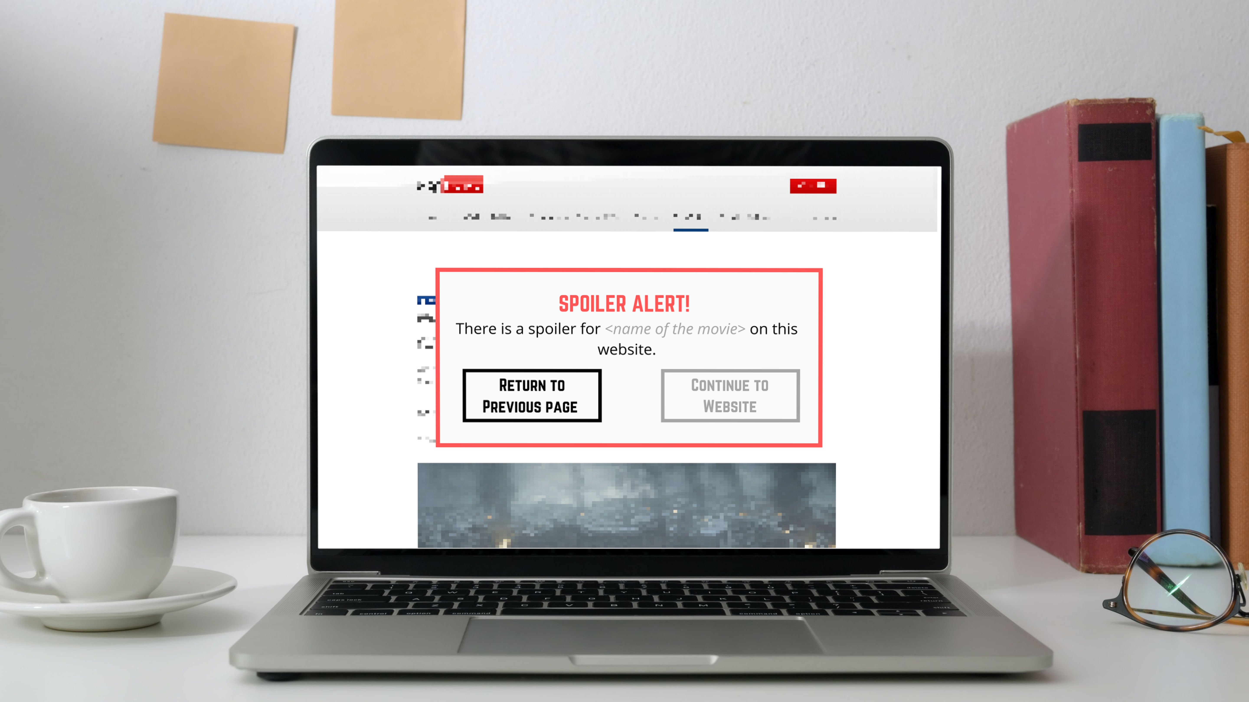
Extension Version 1 Expectations
Input ‘stopwords’ (movie names, character names, etc.).
Get an alert when visiting a website that contains the ‘stopwords’

Slide 8
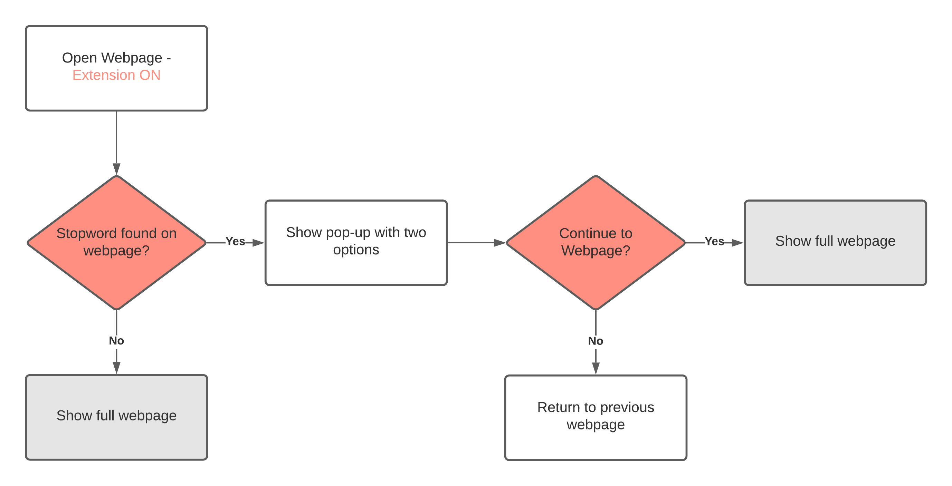
Algorithm Version 1 Expectations

Slide 9
Final Version Project Evaluation
The goal is to create a Chrome web browser extension that works in a similar way to Spoiler Protection 2.0.
Expected features
Ability to selected from a pre-defined list of movies. If the desired movie option does not exist, add name of the movie manually.
Ability to switch between three modes:
Extension OFF – Do not hide any spoilers.
Hidden Mode – hide specific parts of a webpage.
Pop-up Mode – have a pop-up appear when visiting a webpage with spoilers.
Option to select a background color to hide spoilers (only in Hidden Mode).
Project acceptance criteria
Successful development of chrome extension to block spoiler text.
Successful development of machine learning model to classify spoiler text.

Slide 10
Project Assumptions & Constraints
Assumptions
Development of the solution is possible in the timeline defined.
Integrating the chrome extension with the ML algorithm is possible and does not involve using paid services.
Constraints
No Budget for the project ($0)
Product delivery deadline: December 15, 2021 (about two months from

Slide 11
Project Milestones & Schedule
ID | Milestone Title | Expected Duration (days) | Target Complete Date | Deliverables
Phase I: Planning & Initialization
1.1 | Project Plan | 10 | 10/06/2021 | Project Detailed Presentation
1.2 | Extension – V1 | 5 | 10/16/2021 | Chrome Extension
1.3 | Algorithm – V1 | 10 | 10/25/2021 | Baseline Model
1.4 | MVP (Minimum viable product) | 10 | 11/03/2021 | Functional Prototype (20% complete)
Phase II: Solution Development & Testing
2.1 | Extension – V2 | 10 | 11/10/2021 | Updated Chrome Extension
2.2 | Algorithm – V2 | 15 | 11/20/2021 | Model Integrated with Extension
2.3 | MMP (Minimum Marketable product) | 5 | 11/24/2021 | Real Product (75% complete)
Phase III: Implementation & Project Close-out
3.1 | Product Launch | 10 | 12/08/2021 | Complete Product (100% features)
3.2 | Final Presentation | 5 | 12/15/2021 | Formal Product Presentation and Review

Slide 12

Thank you!

